Slide 2
THE DISCIPLES RELATIONSHIP:
TO HIMSELF
An Athlete
A Soldier
TO HIS LORD
The Potter and the Clay
The Vine and the Branches
A Child of God
TO HIS BRETHREN
A Member of the Body
“My Brother’s Keeper”
A Servant
TO THE WORLD
Strangers & Pilgrims
Salt & Light
An Apologist
Fishers of Men

Slide 3
Upcoming Lessons
Lesson 8: “My Brother’s Keeper” – The Disciple’s Support
Love
Consideration
Provocation
Exhortation
Restoration
Good Works
A Good Example
Patience
The Benefit of the Doubt
Forgiveness
Lesson 9: “A Servant” – The Disciple’s Greatness
Why be a servant?
How to be a good servant?
Attitude, Awareness, Action, Availability

Slide 4
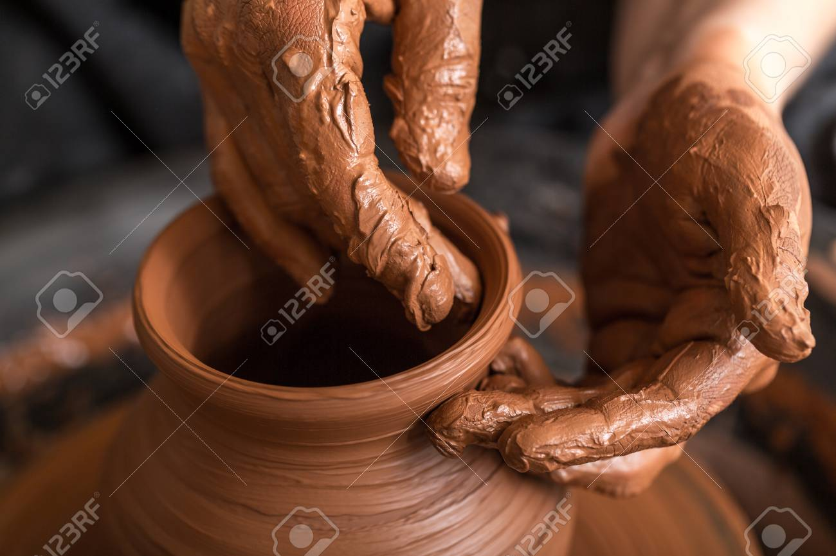
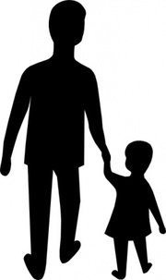
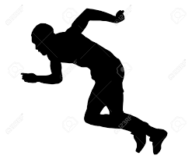
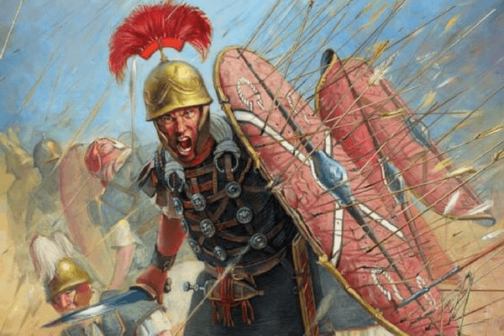
Step Back Recap
Discipleship
Deny Self
Willing to Suffer
Learn From Christ
Bear Fruit
Love Our Brethren
Committed to Following Christ
Relationship with Self
Relationship with The Lord

Slide 5
LESSON 7: A Member of the Body The Disciple’s Place
So we, who are many, are one body in Christ, and individually members one of another. (Romans 12:5)

Slide 6
Christ is the Head; the Church is the Body
“And He put all things in subjection under His feet, and gave Him as head over all things to the church, which is His body, the fullness of Him who fills all in all.” (Eph. 1:22-23)
“Universal” church
Matt. 16:18 “…and upon this rock I will build My church…”
Act. 9:31 “So the church throughout all Judea and Galilee and Samaria enjoyed peace, being built up; and, going on in the fear of the Lord and in the comfort of the Holy Spirit, it continued to increase.”
“Local” Church
Rev 2 & 3 – seven churches of Asia
2Cor. 1:1 “…to the church of God which is at Corinth…”

Slide 7
Christ is the Head; the Church is the Body
Added to the church, the body?
“Universal” church
(Acts 2:41) “So then, those who had received his word were baptized; and that day there were added about three thousand souls.”
“Local” church
(Acts 9:26) When he came to Jerusalem, he was trying to associate with the disciples; but they were all afraid of him, not believing that he was a disciple.”
To associate – to join (KJV, YLT, ESV) – kollao - to glue, that is, to stick, cleave, join (self), keep company.

Slide 8
Benefits of Being in the Body
Salvation is in the Body
If the saved are added to the body (Acts 2:47), then salvation is found in the body
Support and Edification
Heb 3:13 – What is the benefit?
Heb 10:24-25 – What is the benefit?
Gal 6:1,2
Prayer
Acts 12:5 – What was the church doing? How were they doing it?
James 5:14-16
Strength in Numbers
Eccl 4:9-12
1 Pet 5:8

Slide 9
Responsibilities and Diversity
Responsibilities of Being in the Body
Respect God’s Plan and Purpose
Respect the Authority of Christ
Respect the Other Members
Diversity, Yet Equality
Diversity in Backgrounds, but Equal Access to God
Diversity in Functions, but Equally Important
Diversity in Talents, but Unity of Purpose

Slide 10
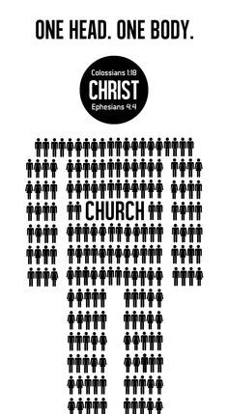
Understanding the Body
Physical Body
Only ONE body (“unity”)
Comprised of individual members
Each member is different and has a role
Each member is important
Each member supports other members / the body
Grows
Church Body
1Cor. 12:12, Eph. 4:4, Rom. 12:5
1Cor. 12:14, Eph. 4:16, Rom. 12:5
1Cor. 12:14-25, Eph. 4:11, 16, Rom. 12:4, 6-8
1Cor. 12:15-16, 21-23
1Cor. 12:26, Eph. 4:12, 16, Rom. 12:10-13
Eph. 4:15-16
1Cor. 12:12-27 | Eph. 4:1-6, 11-16 | Rom. 12:3-13

Slide 11
Understanding the Body
Unity (ONE body)
Each member is different and has a role
Each member is important
Each member supports other members
Growth

Slide 12
Unity
Unity (ONE body)
Each member is different and has a role
Each member is important
Each member supports other members
Growth
“For even as the body is one and yet has many members, and all the members of the body, though they are many, are one body, so also is Christ” (1Cor. 12:12)
“There is one body…” (Eph. 4:4)
“So we, who are many, are one body in Christ, and individually members one of another.” (Rom. 12:5)

Slide 13
Unity
Unity (ONE body)
Each member is different and has a role
Each member is important
Each member supports other members
Growth
“…with all humility and gentleness, with patience, showing tolerance for one another in love, being diligent to preserve the unity of the Spirit in the bond of peace. There is one body…” (Eph. 4:2-4)
“And He gave some as apostles, and some as prophets, and some as evangelists, and some as pastors and teachers, for the equipping of the saints for the work of service, to the building up of the body of Christ; until we all attain to the unity of the faith, and of the knowledge of the Son of God, to a mature man, to the measure of the stature which belongs to the fullness of Christ.” (Eph. 4:11-13)

Slide 14
Each Member is Different
Unity (ONE body)
Each member is different and has a role
Each member is important
Each member supports other members
Growth
“…what every joint supplies…” (Eph. 4:16)
“For just as we have many members in one body and all the members do not have the same function.” (Rom. 12:4)
“Since we have gifts that differ according to the grace given to us, each of us is to exercise them accordingly…” (Rom. 12:6)
“And if the ear says, “Because I am not an eye, I am not a part of the body…”” (1Cor. 12:16)

Slide 15
Each Member is Important
Unity (ONE body)
Each member is different and has a role
Each member is important
Each member supports other members
Growth
“If the foot says, “Because I am not a hand, I am not a part of the body,” it is not for this reason any the less a part of the body” (1Cor. 12:15)
“And the eye cannot say to the hand, “I have no need of you”; or again the head to the feet, “I have no need of you.” On the contrary, it is much truer that the members of the body which seem to be weaker are necessary; and those members of the body which we deem less honorable, on these we bestow more abundant honor, and our less presentable members become much more presentable” (1Cor. 12:21-23)

Slide 16
Each Member Supports
Unity (ONE body)
Each member is different and has a role
Each member is important
Each member supports other members
Growth
“And if one member suffers, all the members suffer with it; if one member is honored, all the members rejoice with it.” (1Cor. 12:26)
“…being fitted and held together by what every joint supplies…” (Eph. 4:16)
“Be devoted to one another in brotherly love; give preference to one another in honor; not lagging behind in diligence, fervent in spirit, serving the Lord; rejoicing in hope, persevering in tribulation, devoted to prayer, contributing to the needs of the saints, practicing hospitality.” (Rom. 12:10-13)

Slide 17
Each Member / The Body Grows
Unity (ONE body)
Each member is different and has a role
Each member is important
Each member supports other members
Growth
“But speaking the truth in love, we are to grow up in all aspects into Him who is the head, Christ, from whom the whole body, being fitted and held together by what every joint supplies, according to the proper working of each individual part, causes the growth of the body for the building up of itself in love.” (Eph. 4:15-16)

Slide 18
The Disciple – A Member of the Body
What are you currently doing to help the body grow? What more could you do?
What member(s) will you help support a little extra this week?
Are there members you don’t know as well as you should? What will you do to know them better this week?

